Slide 1
BE Project: Presentation on, E-Marketplace for customize Package Shopping
By,
Group No: 01
Gauri Brahme (Roll No.: 01)
Ritika Kale (Roll No.: 08)
Urvashi Kandekar(Roll No.: 37)
Dhanashree More (Roll No.: 41)
Guided By
Mr. Vaibhav Dabhade
Dept. of Computer Engineering
MET’s Bhujbal Knowledge City, Institute of Engineering
Notes:
‹#›
*

Slide 2
Index
Overview of domain/area (e.g. Cloud Computing, IP etc)
Introduction
Key Issues related to topic (may vary)
Literature Survey
Problem Statement of your project
Architecture/Design Model/ Mathematical Model
Conclusion
References
*
E-Marketplace for customize Package Shopping
‹#›

Slide 3
Overview
E-marketing means using digital technologies to help reach the customers, create awareness of brand and sell your goods and services.
A unique platform that connects customer and seller in a more efficient way. It is dynamic and you can access everything with just a simple click sitting at your homes
Nowadays, the lifestyle of people is different. People feel uncomfortable and time consuming for going crowded markets. So E-shopping is a boon as it saves lot of time. Online-shopping is a process whereby consumers directly buy goods, services etc. from a seller without an intermediary service over the Internet.
It is very convenient for people to shop online. In this solution customer will also be able to buy a direct package of things. And even seller can sell seasonal products to customer.
*
E-Marketplace for customize Package Shopping
‹#›
Notes:
*
‹#›

Slide 4
Introduction
E-Marketplace with customize package is a solution provided to customer as well as seller. In today’s world, where everything is on Internet and various digital platforms online shopping is one of them where most people today rely on. Due to the advantages like it save times, and various facilities like delivery, everything on one place within one click. This solution includes various modules different for customer, wholesaler and retailer.
On this platform customer and seller will register. And customer can find their required products easily. And seller will able to sell their product more effectively. Also we are providing a solution which is the unique point that is providing a system of customize packaging. Like for example, if there is any Puja at home the things required will be provided in one place. Including this we are providing a module for seasonal products. Like if some shopkeepers nowadays do not have only one business they do some extra things like during some season or according to festival they keep stock of that things for particular period so they can put this on the platform where customer will get to know that the shop near me also provide this things.

Slide 5
Key Issues/Requirement (may vary)
Issues:
When a visitor goes to an E-Commerce platform and sigh up the portal is unaware of the customer, bar the information they entered. Whether the customer is genuine or not remains questionable. Cash on delivery purchases using an invalid or fake phone number or addresses can lead to huge revenue losses.
*
E-Marketplace for customize Package Shopping
‹#›

Slide 6
Literature Survey
Author Shao Guo-Hong[2] proposed Android program design and development, including classes application, program design, development and analysis which is referred here.
Authors M. A. P. Chamikara, Y. P. R. D. Yapa, S. R. Kodituwakku, J. Gunathilake[3] proposed an efficient Algorithm to detect the nearest location of map for a given theme which is referred here.
Author Yongqiang He ; Yanrong Shi ; Aixiang He[4] proposed a common online payment system model with emphasis on the discussion of the electronic credit card, electronic cash, and electronic check of three online payment modes which is used here.
Author Hongyan Xin [5] have done Research on E-Commerce Business Model Based on Intelligent Terminals Mobile which is referred here.
Authors Biswarup Nandi ; Mousumi Ghanti ; Souvik Paul [6] has proposed Text based Sentiment Analysis which analyses customers reviews and sentiments which is referred here.
Author Junnan Chen ; Courtney Miller ; Gaby G. Dagher proposed [7] Product recommendation system for small online retailers using association rules mining which is used to recommend products to the customer according to their search history which is referred here.
*
E-Marketplace for customize Package Shopping
‹#›

Slide 7
Problem Statement
This project aims to develop an online shopping for customers with the goal that it is very easy to shop all the needed items without searching and at one place. It consist of Effortless shopping where all you need to do is select what kind of package you want. This platform is also for the Retail and Wholesale shopkeepers who want to sell their products online where retailers as well as customers can also buy online from wholesaler.
To get to this online shopping system the customers, retail shops and wholesale shops have to register.Upon successful login the customers can purchase a wide range of things which will be dispatched at the doorstep
The ML Algorithms like recommendation system will recommend the products to the customer according to their interest.
*
E-Marketplace for customize Package Shopping
‹#›

Slide 8
Introduction to topic
E-Marketplace with customize package is a solution provided to customer as well as seller. In today’s world, where everything is on Internet and various digital platforms online shopping is one of them where most people today rely on. Due to the advantages like it save times, and various facilities like delivery, everything on one place within one click. This solution includes various modules different for customer, wholesaler and retailer.
On this platform customer and seller will register. And customer can find their required products easily. And seller will able to sell their product more effectively. Also we are providing a solution which is the unique point that is providing a system of customize packaging. Like for example, if there is any Puja at home the things required will be provided in one place. Including this we are providing a module for seasonal products. Like if some shopkeepers nowadays do not have only one business they do some extra things like during some season or according to festival they keep stock of that things for particular period so they can put this on the platform where customer will get to know that the shop near me also provide this things.
*
E-Marketplace for customize Package Shopping
‹#›

Slide 9
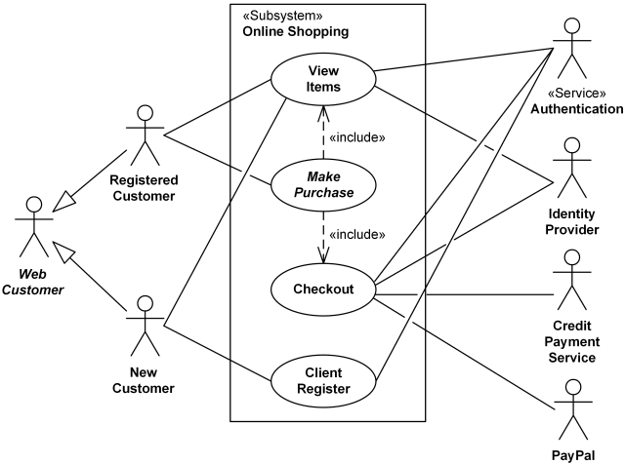
Architecture
*
E-Marketplace for customize Package Shopping
‹#›

Slide 10
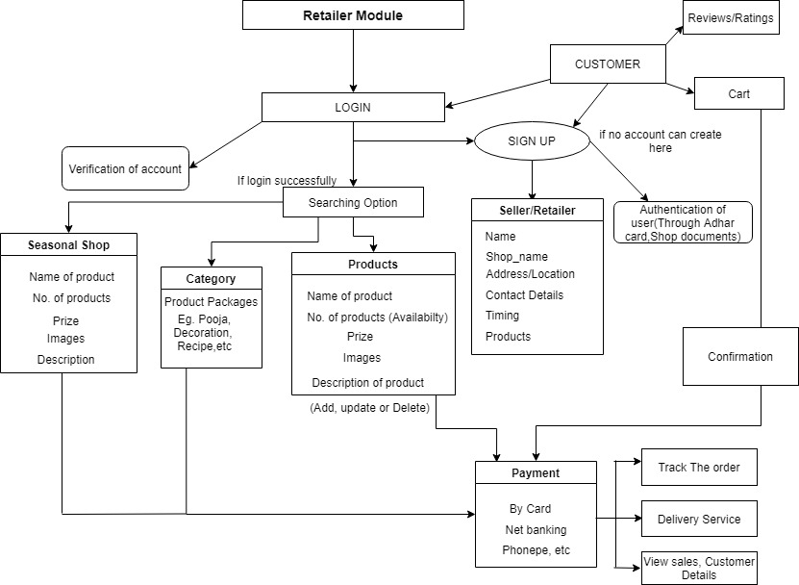

Slide 11
Wholesale Model
Wholesale Seller
Register
Login
1]Name of Business
2]Business Category
3]Contact Details:
Email and Number
Verification
4]Documents Verification
Ex. PAN card, Gov. ID,
NOC, GST no., etc.
-Add products
-Product description
-Product Price
-Min. Quantity to buy
-Update product details like stock over
-Order Notification:
-Order Details
-Pickup order details and time
-Add Offers
-Offer description
-Customer Payment received status

Slide 12
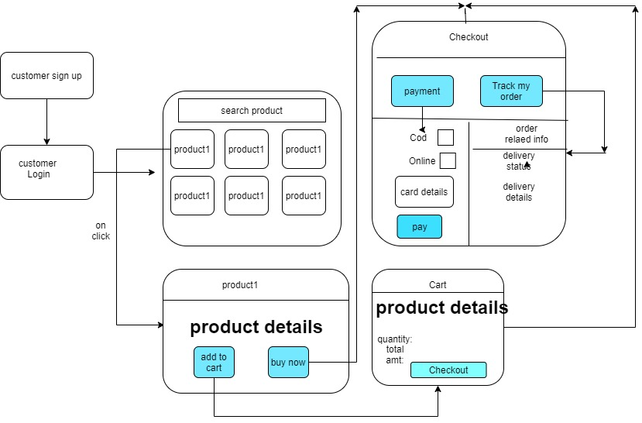
Customer Module

Slide 13
Software, Hardware Required
Software:
Android Studio
Flutter
Firebase for database connectivity
Flask
Jupyter Notebook
Hardware: Not required
*
E-Marketplace for customize Package Shopping
‹#›

Slide 14
Conclusion:
The project exposed us to the technology in the area of E-marketing. This project demonstrates the application based “E-Marketplace for custom packaging shopping.” From this we can conclude that this project will be helpful for both customer as well as seller. For seller this platform will give a chance to sell their products online. As well will be able to sell various seasonal packages. As there is no intermediary service the customer can directly connect to the shopkeeper.
This solution will help the customer to find the nearby shops easily and will save the time of the customer. Also most of the online stores are usually available 24 hours and many consumers have internet access both at work and home. So it is very convenient for them to shop online.
*
E-Marketplace for customize Package Shopping
‹#›

Slide 15
References:
[1] ZHANG S C. Development and Research of Application Based on Google Android [J][J]. Computer Knowledge and Technology, 2009, 28
[2]Shao Guo-Hong Android development Research and Based on Android Platform, 2014
[3]M. A. P. Chamikara, Y. P. R. D. Yapa, S. R. Kodituwakku, J. Gunathilake , An Efficient Algorithm To Detect The Nearest Location Of A Map For A Given Theme, APRIL 2013.
[4]Yongqiang He ; Yanrong Shi ; Aixiang He (19 August 2010), Research on online payment mode of e-commerce.
[5]Hongyan Xin, (10 March 2016), Research on E-Commerce Business Model Based on Intelligent Terminals Mobile.
[6]Biswarup Nandi ; Mousumi Ghanti ; Souvik Paul, (23-24 Nov. 2017), Text Based Sentiment Analysis.
[7]Junnan Chen ; Courtney Miller ; Gaby G. Dagher, (29 September 2014), Product recommendation system for small online retailers using association rules mining.
*
E-Marketplace for customize Package Shopping
‹#›

Slide 16
Publications and Competition Status
Sr. No. | Conference/Journal /Competition | Status | Remark (if any)
1. | CSI Project Competition, DISQ | Registered
*
E-Marketplace for customize Package Shopping
‹#›

Slide 17
Thank You
*
E-Marketplace for customize Package Shopping
‹#›

